Slide 1
Analyzing Competitor Activities Using Social Media Data

Slide 2
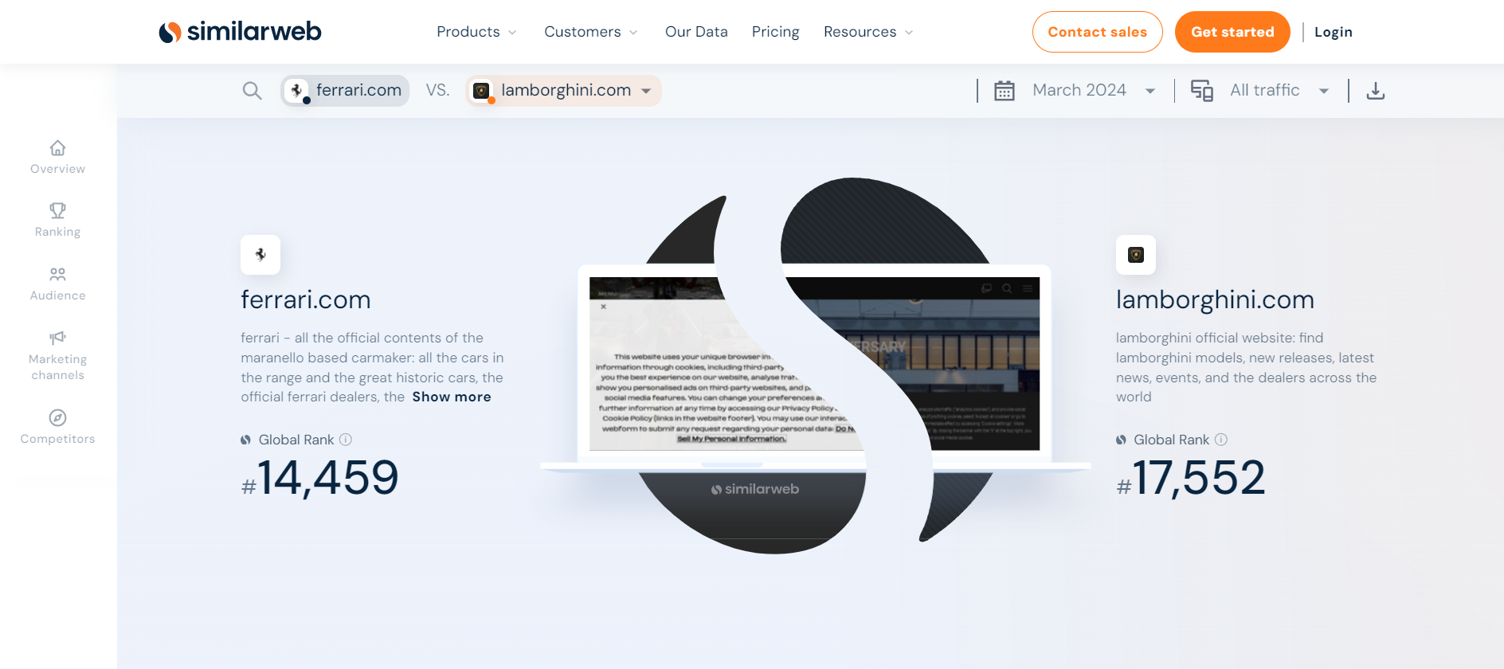
Using Similar web

Slide 3
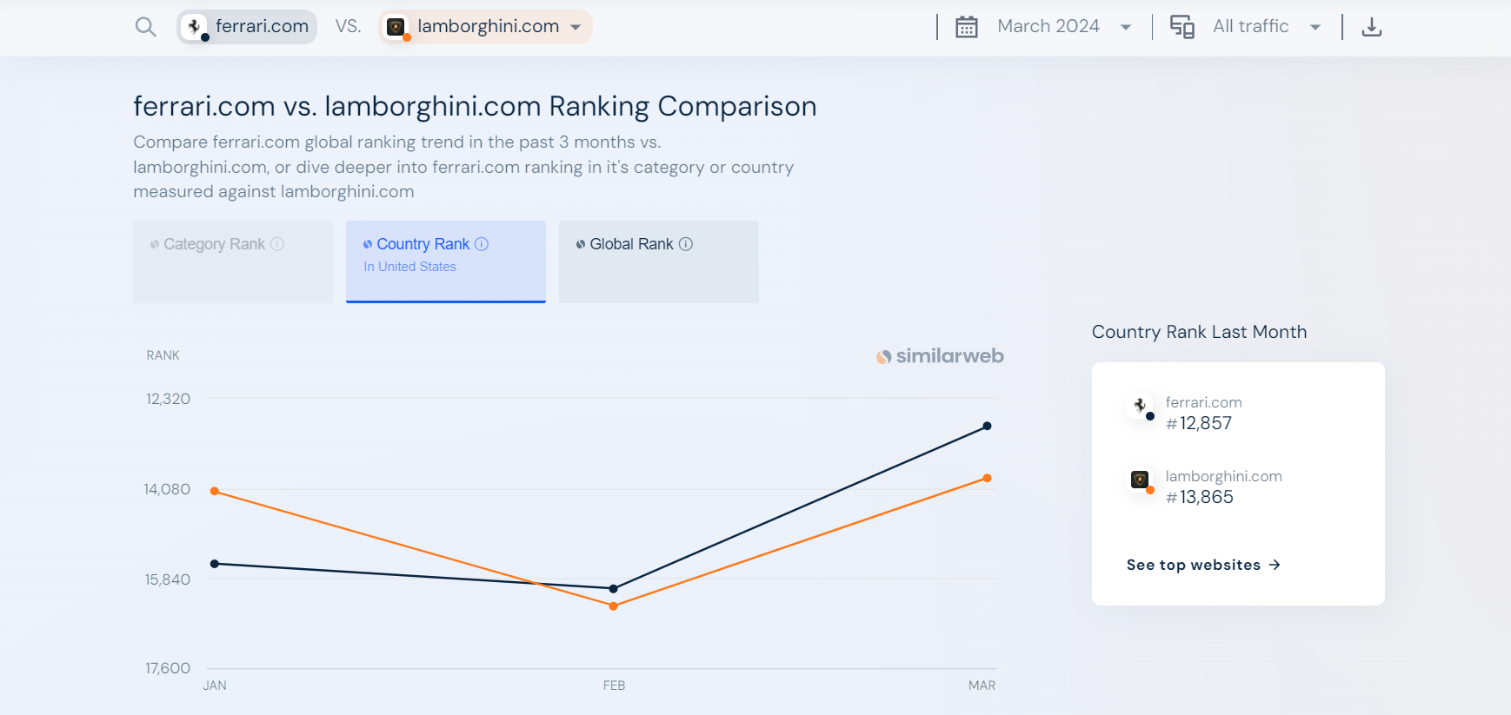
Ranking Comparison

Slide 4
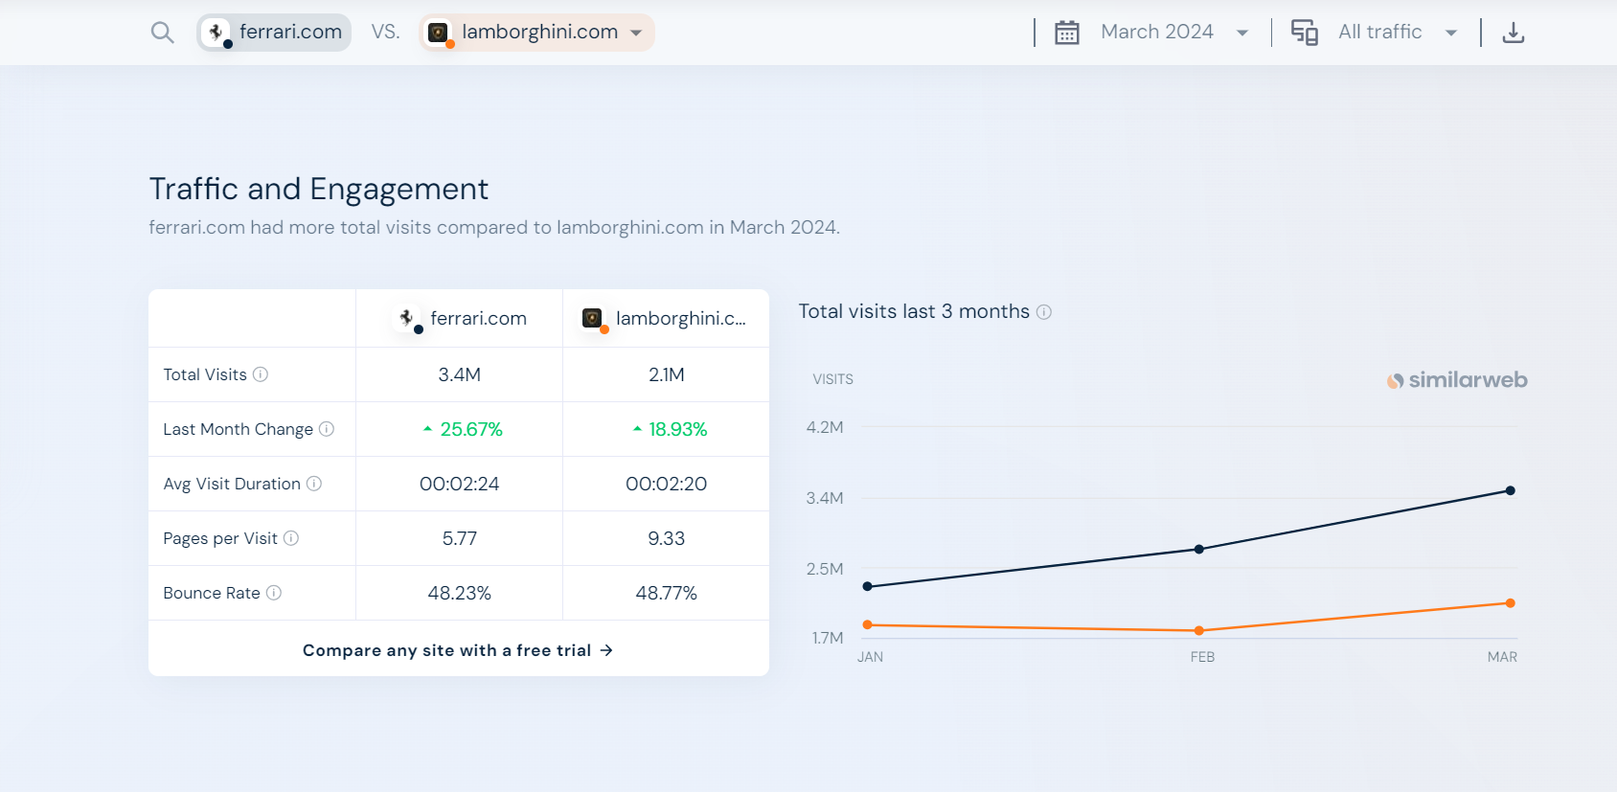
Traffic & Engaement

Slide 5
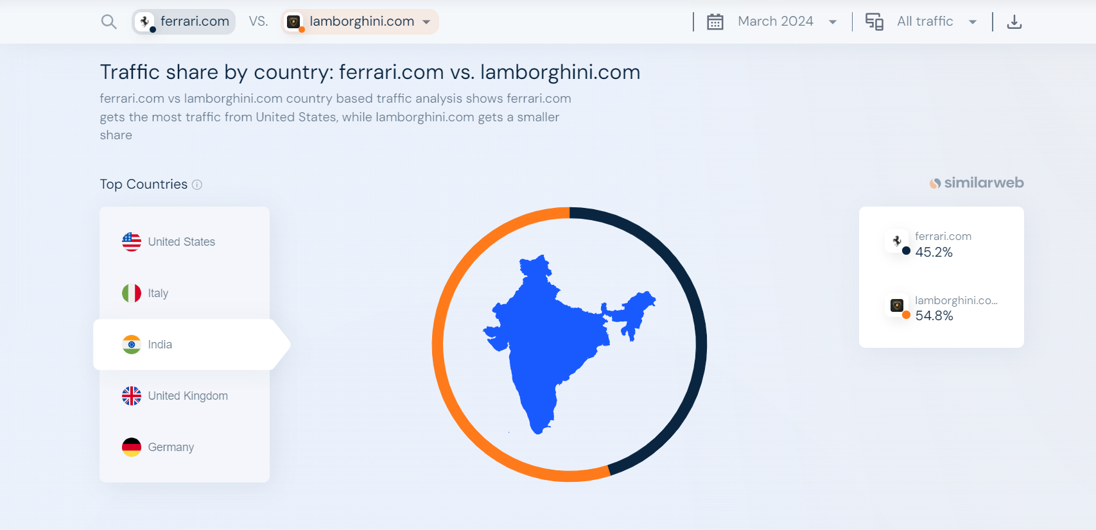
Using Similar web

Slide 6
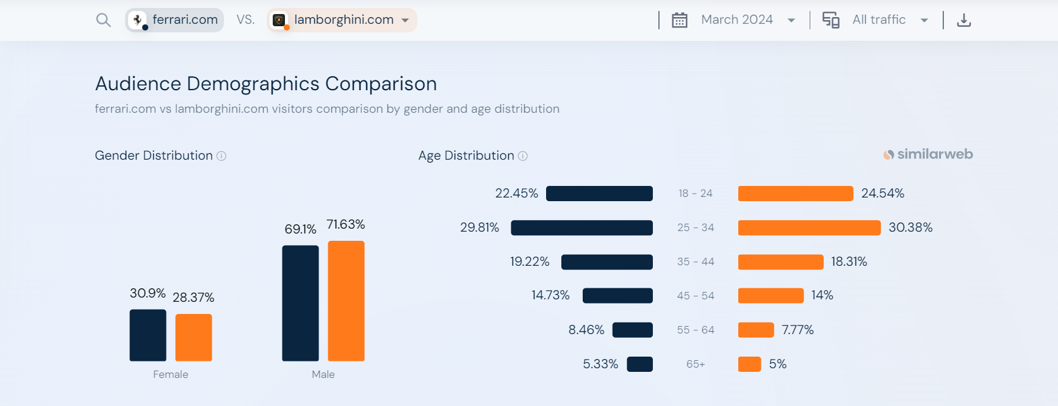
Audience Demographic Comparison

Slide 7
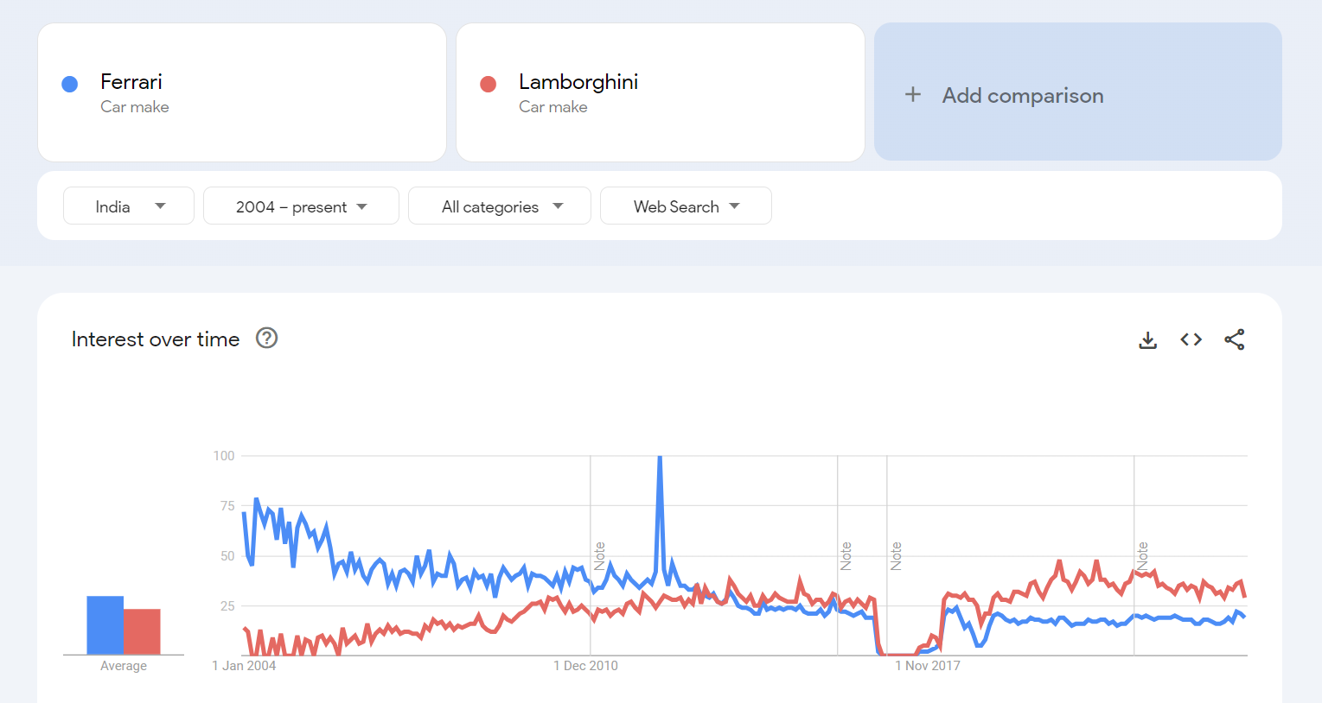
Using Google Trends

Slide 8
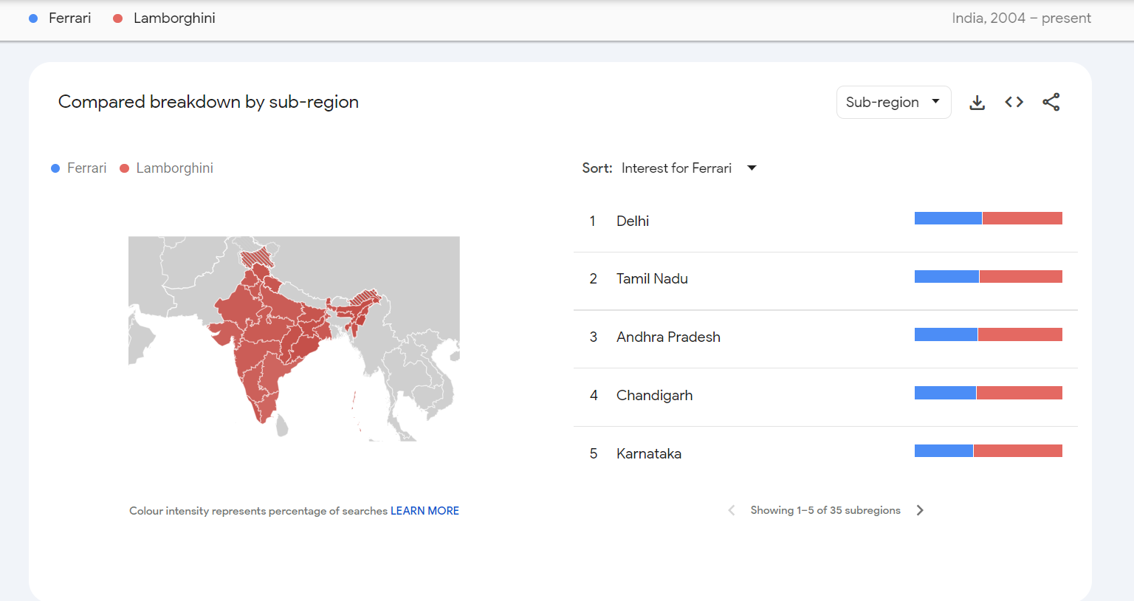
Breakdown by Sub-Region

Slide 9
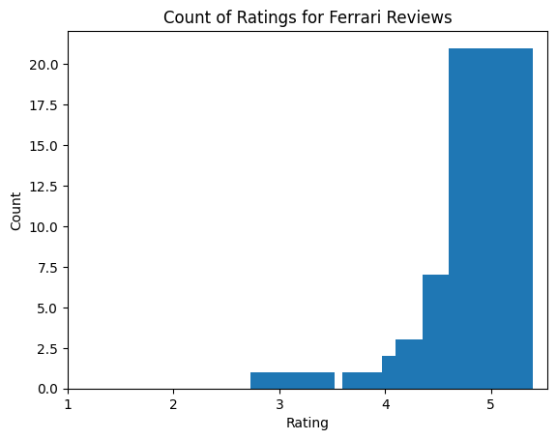
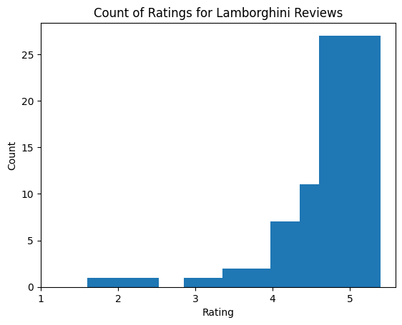
Using Python

Slide 10
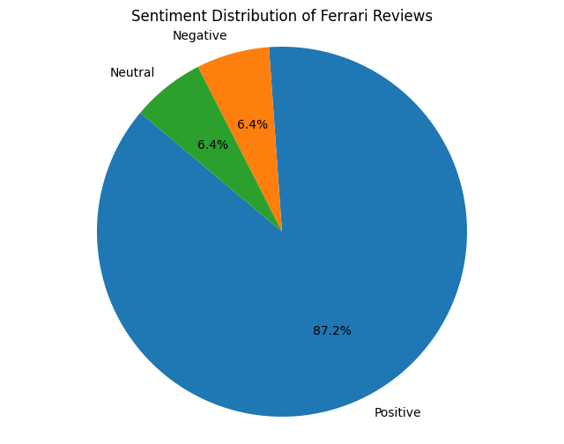
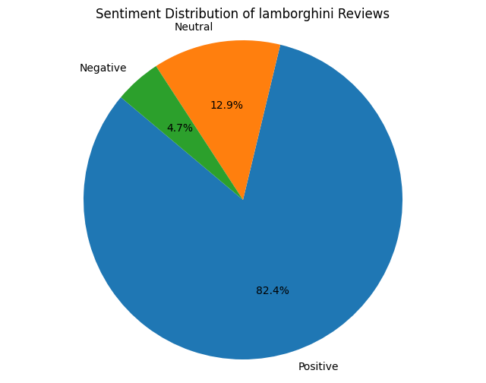
Using Python

Slide 11
Conclusion
In the realm of technical social analysis, comparing the capabilities of Similar Web for analyzing competitor activities provides a nuanced understanding of digital landscapes. Majestic excels in backlink analysis, offering deep insights into competitor link profiles and authority. On the other hand, Similar Web provides comprehensive data on web traffic, audience demographics, and engagement metrics. By integrating both tools, technical social analysts can paint a holistic picture of competitors' online strategies, allowing for precise adjustments and strategic optimizations. This synergy enables analysts to stay agile, anticipate market shifts, and drive impactful social media campaigns with informed precision.

